Slide 1
It is a place where …(это место где) | Our school is (прилаг)
I like …at school | (Our my Favourite subject is …
school

Slide 2
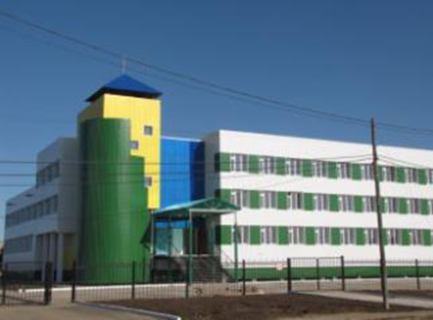

Slide 3
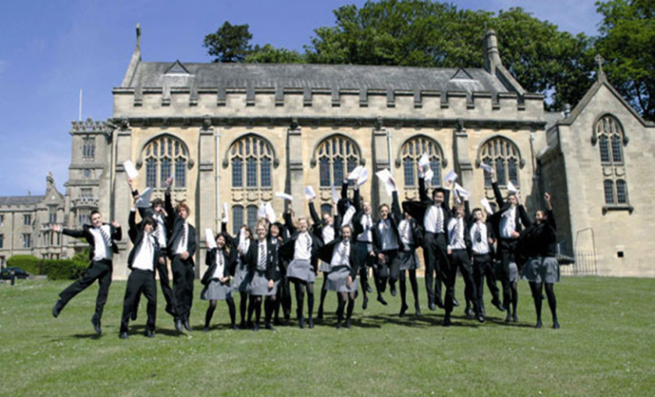
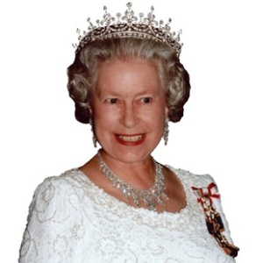
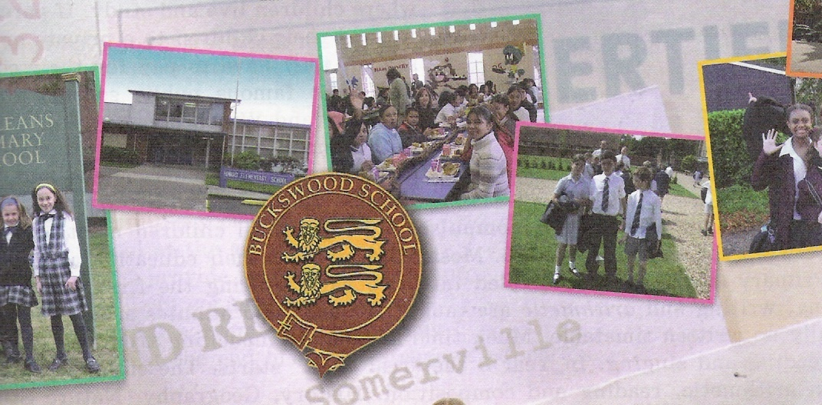
State school
Teacher
GCSE (General Certificate of Secondary Education)
Boarding school
Drama
All-boys school
Food Technology class
Independent school
All-girls school

Slide 4
Schools in Britain

Slide 6
School subjects | Types of schools | School items
Chemistry | Independent school | Desk
Art | Boarding school | Blackboard
History | Secondary school | Eraser
French | State school | Pencil case
Food Technology class | Primary school | Ruler
Science | All-boys school | Uniform

Slide 7
Independent school
GCSE (General Certificate of Secondary Education)
Term
State school
Primary school
Boarding school
Secondary school
All-boys school
Mixed schools
School canteen
Food Technology class
Школа интернат
Школы, где учатся вместе мальчики и девочки
Аттестат
Школа для мальчиков
Частная школа
Урок по кулинарии
Школьная столовая
Четверть
Начальная школа
Государственная школа
Средняя школа

Slide 8
Физминутка
Put your hands up in the air
and shake your bodies round
Hands upon your toes
and turn around around
Hands wave high
Hands wave low
Stamp with your feet and
jump jump jump﻿

Slide 9
Children in Britain start school when they are five. Many boys and girls usually leave school at the age of sixteen.
In England the school year begins in September.
Classes usually begin at nine. At half past twelve or at one o’clock they usually have lunch – meat, pudding, juice, an apple or a cake. Their classes are not formal. They often sit on the carpet on the floor and listen to their teacher. They draw or play games. They look after the animals they have at school – hamsters, rabbits. Sometimes there are birds or fish in their classrooms.

Slide 10
What?
When?
Where?
How many?

Slide 11
1. When do children go to primary school?
2. When do children go to secondary school?
Do children go to school on Saturday?
4. When does school start?
5. Who studies at school?
6. What do they wear at school?

Slide 12
Running dictation.
Children in Britain start school when they are five.. Many boys and girls usually leave school at the age of sixteen.
In England the school year begins in September, but not always on the first day of the month, as school never begins on Monday. The English think that Monday is not a good day to start school. So pupils usually begin their school year on the first Tuesday of September (not always on the 1-st of September as we do).
Classes usually begin at nine. Pupils have a glass of milk or a glass of orange juice at eleven. At half past twelve or at one o’clock they usually have lunch – meat, pudding, juice, an apple or a cake. Their classes are not formal. They often sit on the carpet on the floor and listen to their teacher. They draw or play games. They often look at the animals they have at school – hamsters, rabbits or hares. Sometimes there are birds or fish in their classrooms.

Slide 13
How to grade each other.
If everything is correct or if there is one or two mistakes made you give a 5 mark.
If there are 3 or 5 mistakes made then you give a 4 mark.
And 6 or 8 mistakes made you give a 3 mark.

Slide 14
Сегодня на уроке я узнал, что….
Today in this lesson I have learnt that…
Я хочу сказать ….
I’d like to say (that)…
Я хочу поблагодарить за интересный урок
I’d like to thank

